Slide 1
EFFICIENT STEGANOGRAPHIC TECHNIQUE USING SECURED DATA HIDING WITH BIT STREAM DATA TRANSFER.
BY SUJITHA.S
NANDHINI.V
KALPANA.P
GUIDE : DEVIPRIYA .S

Slide 2
PROBLEM STATEMENT
In current scenarios have propose single image with data hiding , it doesn’t provide satisfactory security . So efficient steganography technique using secured data hiding with bit stream data transfer will be propose with dual image data hiding to improve the security.

Slide 3
ABSTRACT
Efficient steganography technique with dual image , that one is cover image and other one is spatial embedding image by incorporating the statistics of both the spatial and DCT domains. The spatial statistics of the decompressed JPEG images , data is hide in embed space with the distortion measures of some efficient steganographic schemes in the spatial domain.

Slide 4
LITERATURE SURVEY
Adaptive steganography, hypothesis testing theory
proposed by Jessica Fridri , Remi – Content Adaptive
Steganography by minimizing statistical detectability in 2017.
Adaptive steganography , embedding probabilities,
Re embedding propose by Weixuan Tang ,Haodong li –
Adaptive steganalaysis based on embedding
probabilities of pixels in 2015.
Color channel correlation, modification direction,
Steganalysis proposed by Weixuan Tang, Bin Li – Clustering
Steganography modification direction for color components in
2016.

Slide 5
NAME OF THE PAPER | METHOD | TOOLS /TECHNOLOGY | ADVANTAGES | DISADVANTAGES
Content –Adaptive Steganography by minimizing statistical detect ability | Adaptive steganography, Hypothesis testing theory | It uses distortion function & LSB matching | Most powerful detection of content adaptive LSB matching | complex enough to capture non-stationary character of natural images
Adaptive steganalaysis based on embedding probabilities of pixels | Adaptive steganography , embedding probabilities, Re embedding | Non-Adaptive technology & S-UNIWARD(distortion function) | Highly concentrated on the textual regions within an image | Such regions are difficult to model for steganalysis
Clustering Steganography modification direction for color components | Color channel correlation, modification direction, steganalysis | CMD-C (Clustering modification directions for color components) | Increase empirical security | It is unclear to preserving the channel correlation

Slide 6
REQUIREMENT ANALYSIS FOR EACH MODULE
MODULE 1 : Key image , cluster division , and random permutation algorithm.
MODULE 2: Original image use to hided the text using LSB algorithm.
MODULE 3: Combined both images using random permutation algorithm , encrypted the file using MD5 algorithm and compressed the image using Image lossyless compression algorithm.
MODULE 4: Decompressed the file using reverse of Image lossyless compression and decrypted the file using reverse of MD5 algorithm.
MODULE 5: Extracted the image and the hided text.
FRONT END: .Net
BACK END: C#

Slide 7
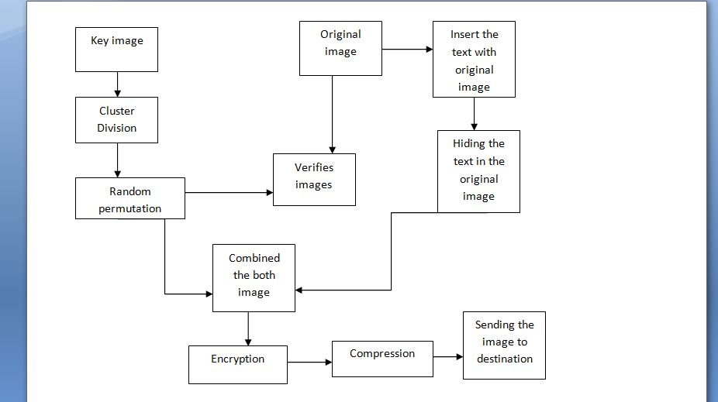
ARCHITECTURE DIAGRAM ENCRYPTION OR SENDER SIDE

Slide 8
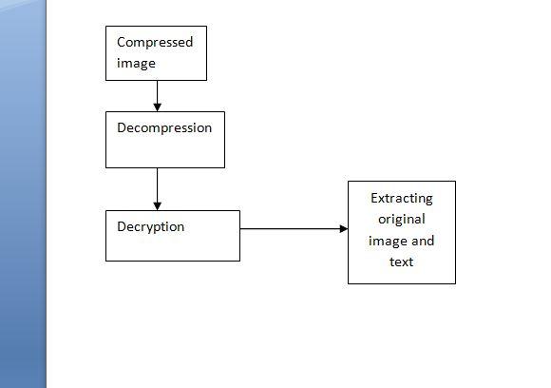
DECRYPTION OR RECEIVER SIDE

Slide 9
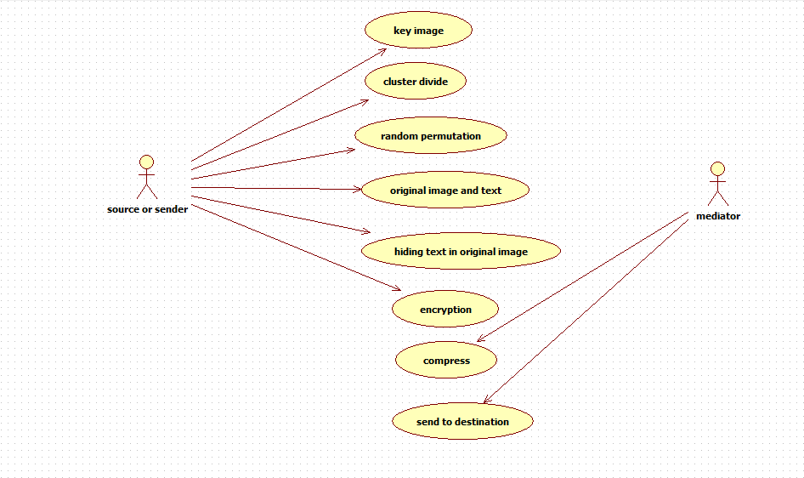
USE CASE DIAGRAM ENCRYPTION OR SENDER SIDE

Slide 10
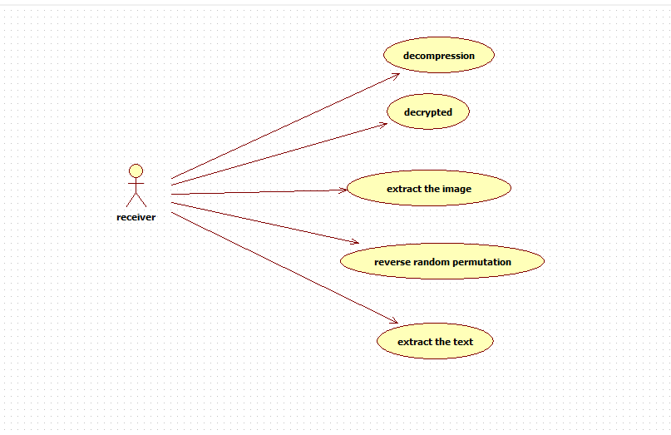
DECRYPTION OR RECEIVER SIDE

Slide 11
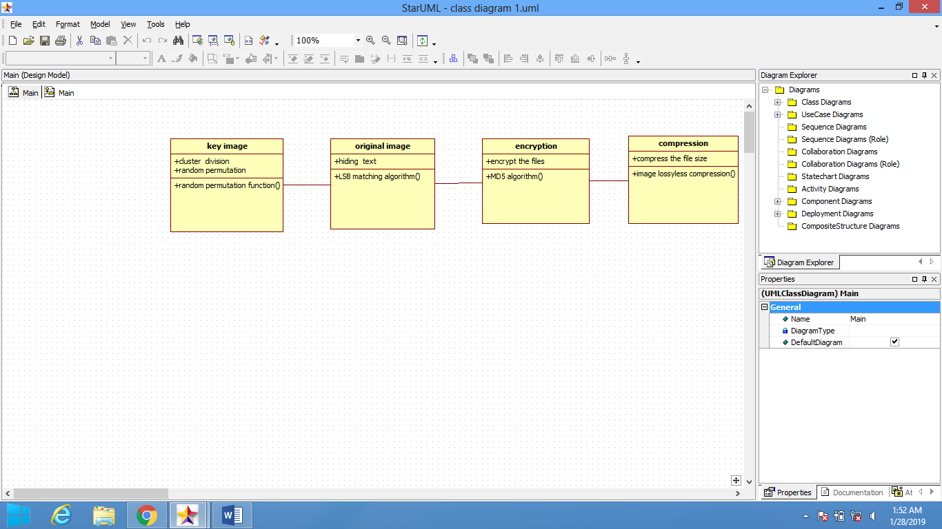
CLASS DIAGRAM FOR ENCRYPTION

Slide 12
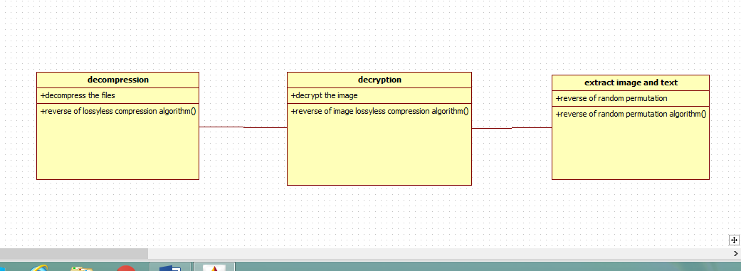
CLASS DIAGRAM FOR DECRYPTION

Slide 13
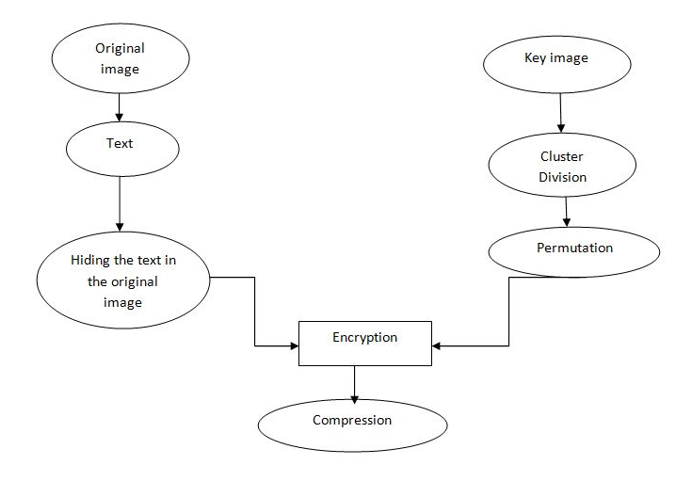
ER DIAGRAM ENCRYPTION OR SENDER SIDE

Slide 14
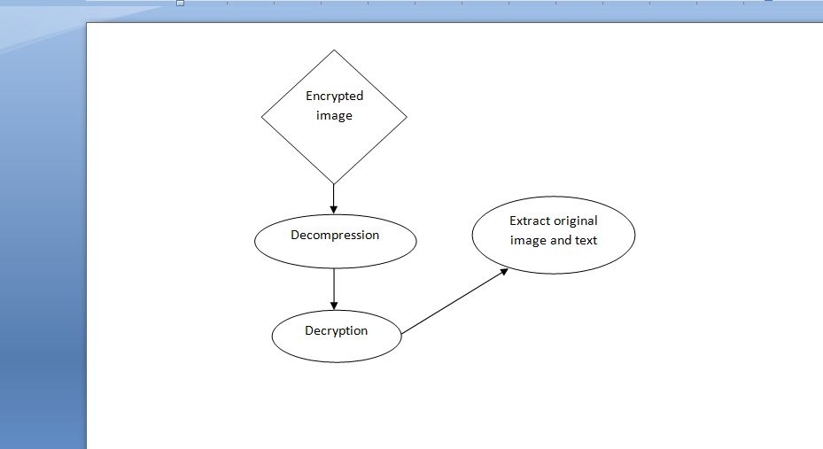
DECRYPTION OR RECEIVER SIDE

Slide 15
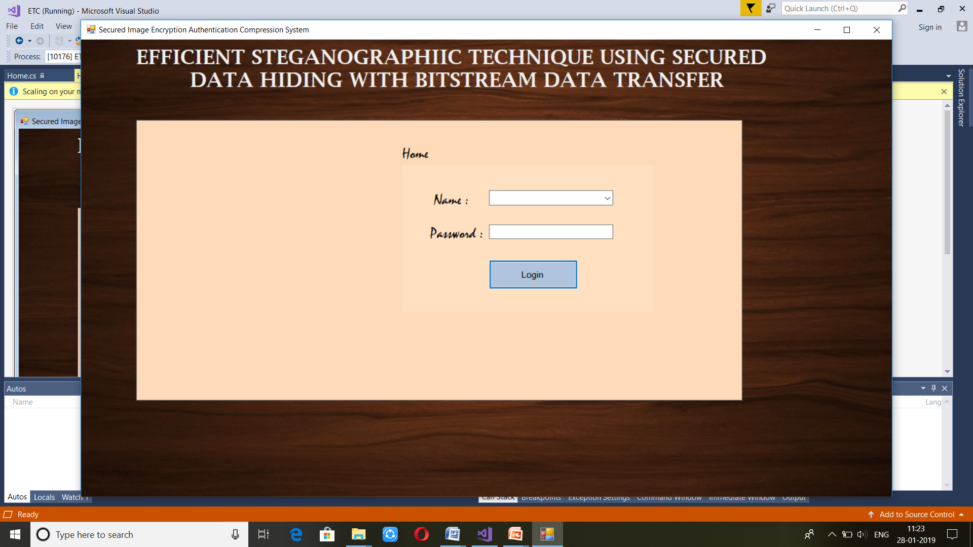
MODULES(LOG IN)

Slide 16
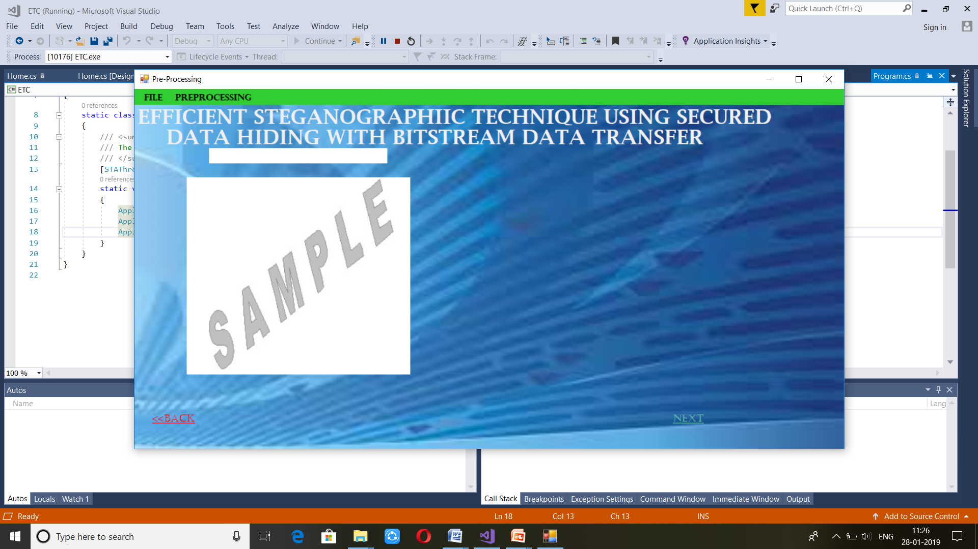
Pre-processing

Slide 17
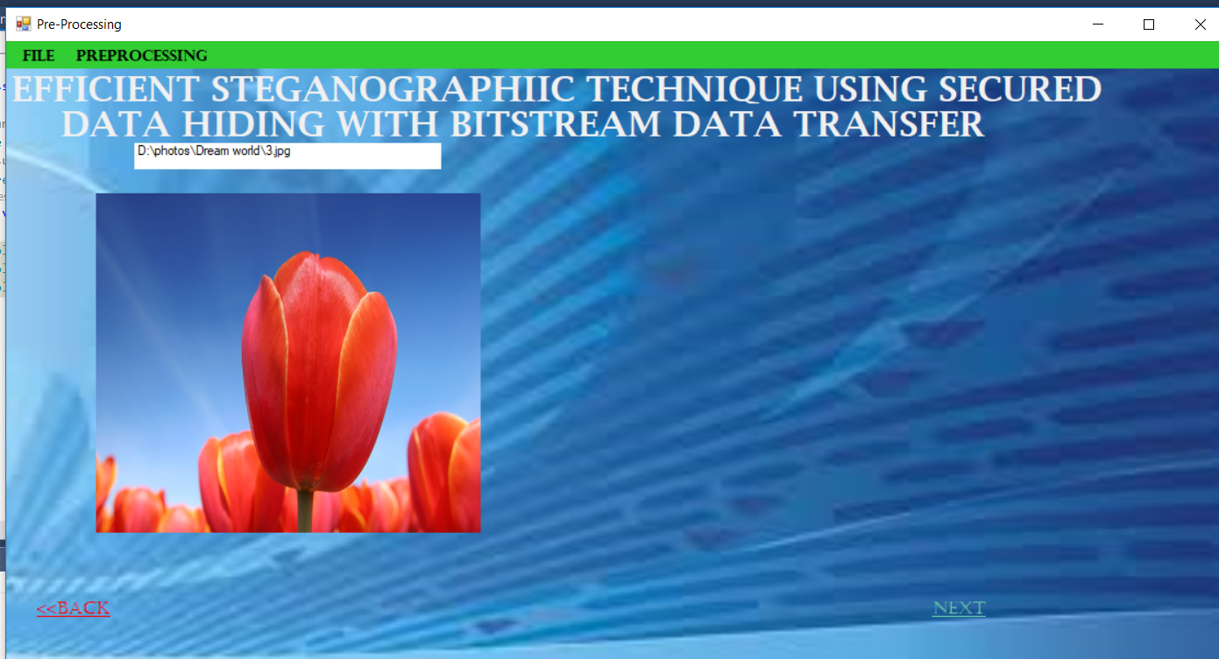
Importing Image

Slide 18
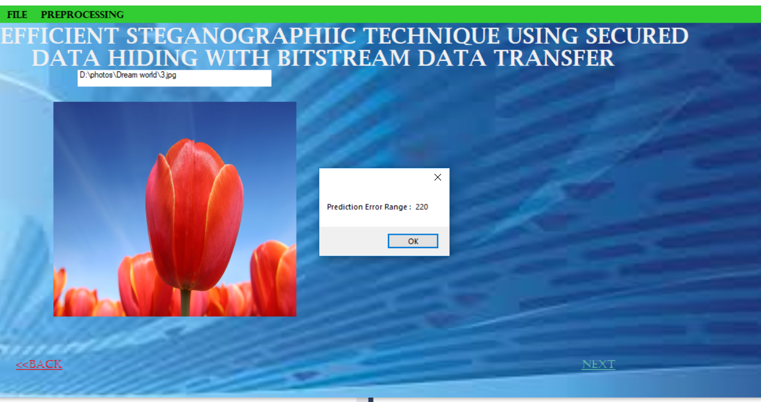
Prediction of errors

Slide 19
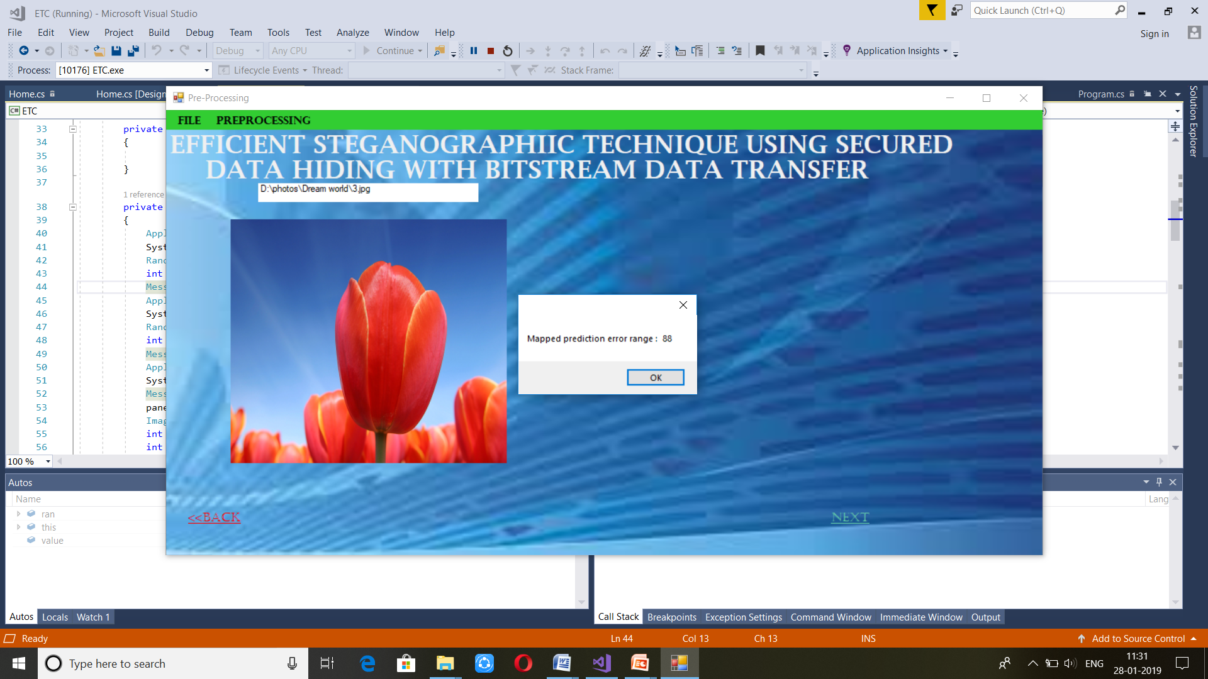
Mapping of prediction errors

Slide 20
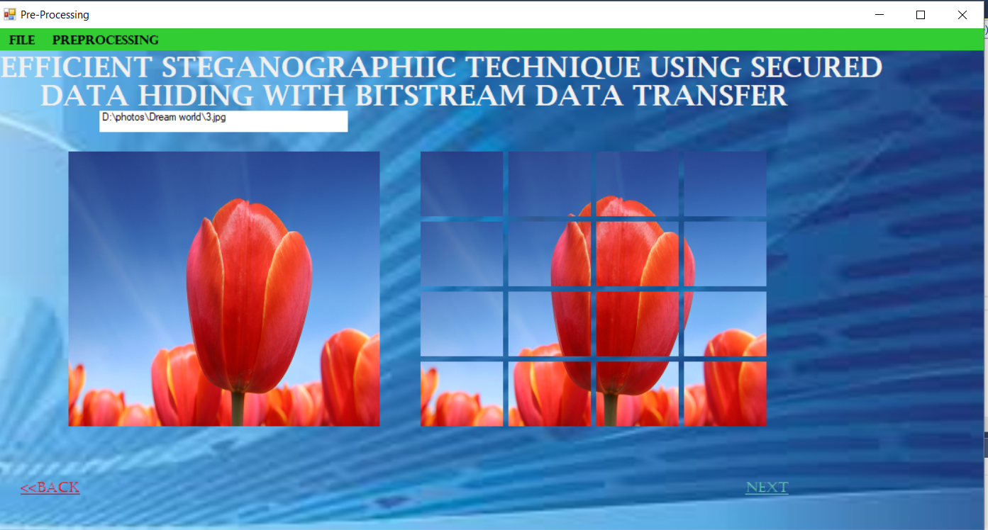
Cluster division

Slide 21
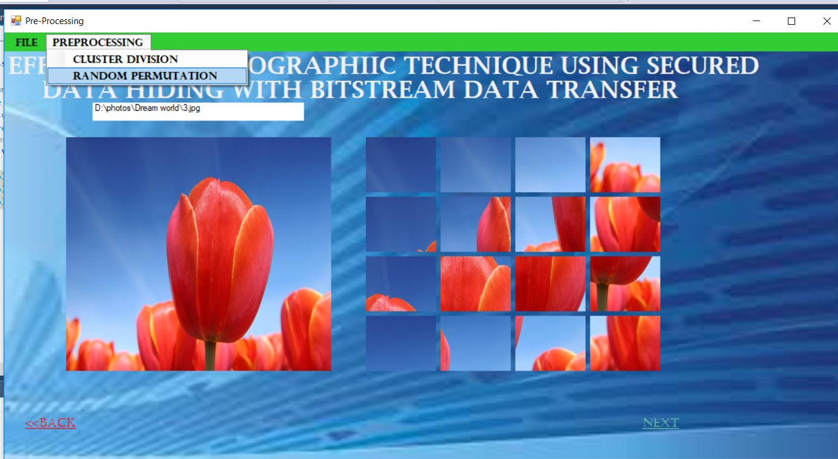
Random permutation

Slide 22
CONCLUSION
To improve the security performance of JPEG steganography in the spatial domain, dual image steganography with data hiding should be compressed and transfer.

Slide 23
ANY QUERIES

Slide 24
Referrence
sedighi2016.pdf
tang2015.pdf
tang2016.pdf

Slide 25
THANK YOU

